Slide 1

Your firm’s own AI.
Nothing leaves the building.
Private, on-premises AI for firms. We buy the hardware, build it, configure it around the way you already work, and hand you the keys.
ARCUS MONS
HARDWARE · BUILD · CONFIGURATION · TRAINING · SUPPORT

Slide 2
WHERE THIS STARTS
AI is already inside your firm
That decision has already been made — by your associates, your paralegals and your assistants. The open question is whose computer your client files sit on when it happens.
78%
79%
11%
of employees say they use unapproved AI tools
of legal professionals report using AI tools — while 44% of firms have no AI policy at all
of everything employees paste into AI tools is sensitive material
WalkMe / SAP, AI in the Workplace Survey, 2025
Clio Legal Trends, cited by the NC Bar Association, 2026
Cyberhaven, 2026
Every one of those sessions runs on a server you do not own, under terms you never negotiated.

Slide 3
THE INVISIBLE PATH
What actually happens when an employee pastes in a client document
The file
A personal account
Someone else’s servers
Out of your hands
A demand letter, a deposition excerpt, a client’s medical record.
Free tier, personal email, no admin console, no record on your side.
Held under consumer terms your firm never reviewed or signed.
Retention you do not set, training you cannot audit, breach and discovery exposure you inherit.
No log. No copy. No answer for the client who asks where their information went.
The firm carries the obligation. The vendor carries the data.

Slide 4



THE ALTERNATIVE
One server. In your office. Behind your lock.
An AI model running on hardware the firm owns, reached through a browser like any other internal system.
You own the box
Traffic stops at your walls
Everyone gets a seat
It sits in your server closet or a locked cabinet. A firm asset on the balance sheet, not a subscription line that renews forever.
Prompts, documents and answers stay in the firm network. The server does not need an internet connection to answer a question.
One person or thirty, the server costs the same. No per-head license or subscription.

Slide 5

HOW IT WORKS
One server, inside your perimeter
YOUR OFFICE NETWORK
Attorneys
Your AI server
Open WebUI — the chat interface your team signs into
Paralegals & staff
The public internet
A local model — GPT-oss, Qwen or Gemma, selected to best fit your business
Not required. We can block it outright, or open only what you approve — a web-search tool, or a cloud model accessible from anywhere.
Authorized users
Admin Account — Can look at all of the chats and documents from all authorized users
Everything above happens on hardware in your building.
If your internet connection drops, the AI keeps working.

Slide 6
WHAT YOUR TEAM SEES
It looks like the tool they are already using
Familiar on day one
Summarise this deposition — admissions only
A chat window with a message box. Nobody needs to learn a new way of working.
Their own sign-in
Each person has an account. What they can reach is set by their role in the firm.
A shared prompt library
The firm’s best prompts written once, then available to everyone as a single click.
Which exhibits does he dispute?
Answers from your own files
Load various files and ask questions about it directly.
Ask anything — it stays in the office
Nothing to install
Hall & Rivera LLP
Accessible to any browser on the network that is given access. Desktop, laptop or phone, in the office.

Slide 7




THE PART THAT MATTERS
Configured around how your firm actually works
The value is in the setup — and this is the work we do with you on site.
Groups and permissions
Sign-on and offboarding
Partners, associates, paralegals, employees — each group sees only the models and collections it should.
Enable user registration when hiring new associates. Delete account access when an associate departs from the company.
Approved models only
Retention and records
Only the models you have vetted appear in the menu. No silent switch to something new.
Chat retention set to your policy, deletion locked where you need a record. Compete admin visibility.
You get a written record of every setting we apply, just in case you want to change it later.

Slide 8
STRAIGHT ANSWERS
The four questions we always get
Will this server be as good as ChatGPT/Claude?
What happens if it breaks?
For the work a firm does most — summarising, drafting and searching your own documents — it is close enough that most people cannot tell the difference. For the hardest cognitive reasoning, the frontier cloud models still have a slight edge.
The AI hardware we utilize comes with a 1-year warranty from the factory. We offer 1-Year of free tech support/repair if the issue stems from initial setup/deployment.
What is the lead time?
Who has access to the server?
From ordering the AI computers to a fully deployed server is about 3-4 weeks, mostly dependent on hardware availability.
After the server is built, configured, and deployed the only people who have access to it are of your choosing.
Notes:
Answer these before they are asked. A security buyer trusts the vendor who names the limits of the product. Never claim the system makes them compliant, and never claim it removes the duty to check output. Both claims are false and a lawyer will catch them immediately.

Slide 9
THE ENGAGEMENT
What we do, in order
1
2
3
Build Phase
Install and Deploy
Train and Hand Over
Order the AI server computers and configure it with LLM software and code.
On-site installation, accounts and access creation, with a written record of all settings changed.
One hour hands-on learning session for the admin to understand the software, start up and shutdown procedures. Applicable documentation is supplied.
One firm, one box, one point of contact — us.
Notes:
Add your actual timeline to this slide before presenting — most buyers ask "how long?" within a minute of seeing it. Step four is where you separate yourself from a hardware reseller. Training and the written policy are what a managing partner is actually buying.

Slide 10
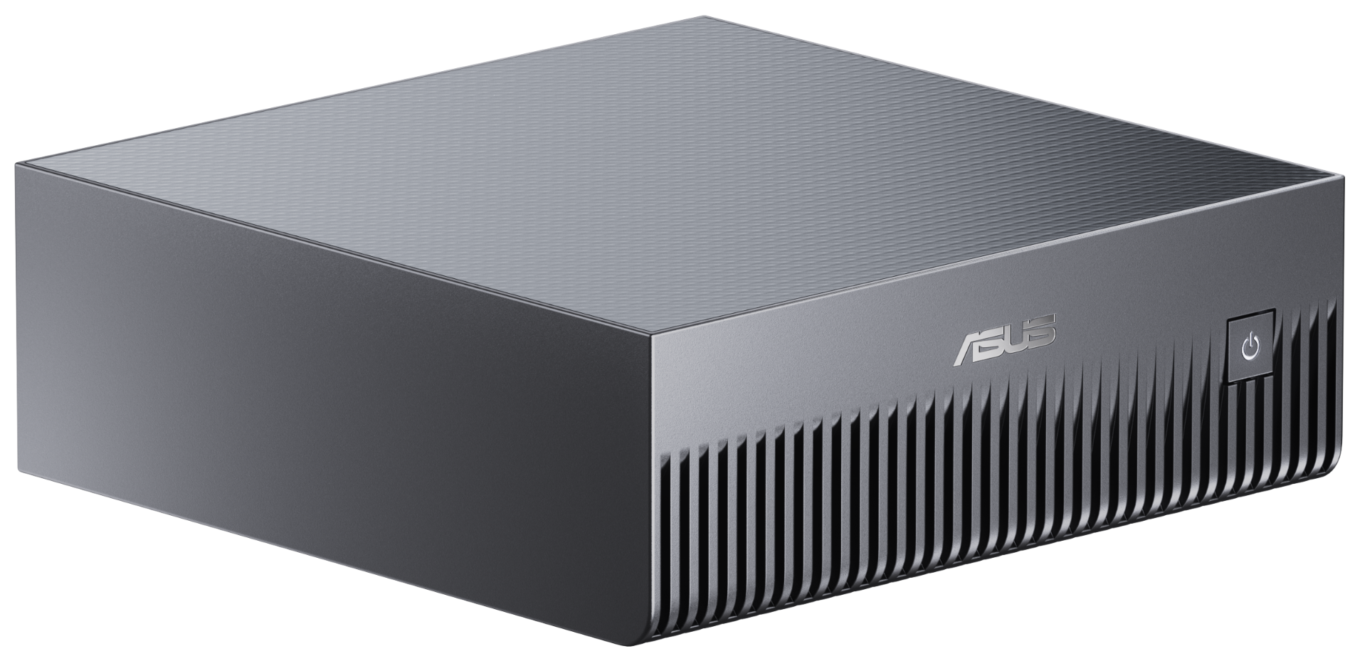
THE HARDWARE
Small footprint. Silent operation.
The ASUS Ascent GX10 is about the size of a hardback book and light enough to move with one hand. It sits on a desk or a shelf, out of the way, and runs quietly enough that no one in the room notices it's there.
HEIGHT
2.01 in
WEIGHT
⚖
3.26 lbs.
Light enough to lift with one hand
WIDTH & DEPTH
5.91 in × 5.91 in

Slide 11
WHAT IT COSTS
What you pay, and what you don't
Hardware you own outright, a flat setup fee, and the cost to keep it running. No subscription, no per-seat pricing, no per-query charges.
$4–8K
$2K
~$5/mo
for the server itself — one-time, yours to keep
flat setup fee — install, configuration, and staff training
to run it 8 hours every weekday, drawing 280W at 13¢/kWh
Depending on the model and storage you need
Paid once, at handover
Based on typical usage and average electricity rates
That's the whole bill. No subscription, no per-seat fees, no surprises later.

Slide 12






THE BOTTOM LINE
Everything a private AI server gives your firm
All of it matters — but the one that matters most is that your clients' data never leaves your building.
Client data never leaves your walls
You own the hardware, not a subscription
One flat setup fee, then almost nothing
The model, the files, and every chat happen on hardware you own. No vendor sees a prompt, a document, or a query log.
The server is yours outright. No per-seat fees, no usage caps, and no license that can be revoked.
A one-time build cost and a few dollars a month in electricity.
Looks like the tool they already use
Configured to how you actually work
Installed, trained, and supported
A chat interface your team already understands, so there's nothing new to teach.
Groups, permissions, and retention rules set up around your practice.
We handle setup, staff training, and hand-off.

